Slide 1

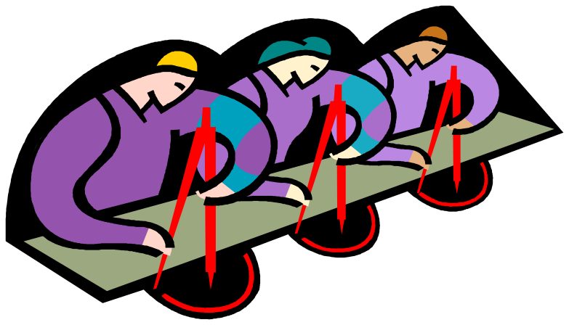
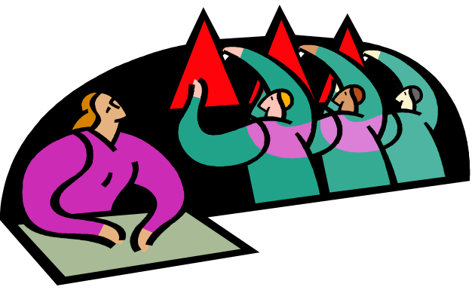


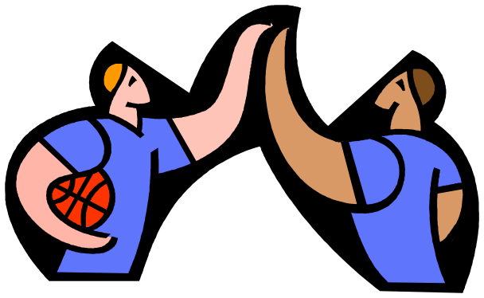


Multiple Intelligences

Slide 2
Multiple Intelligences click on each picture
Linguistic
Musical
Logical/
Mathematical
Naturalist
Spatial
Intrapersonal
Bodily/
Kinesthetic
Interpersonal

Slide 3
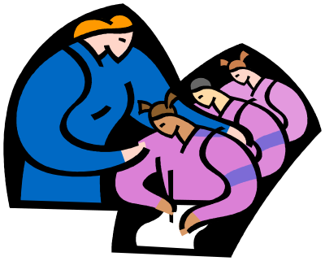
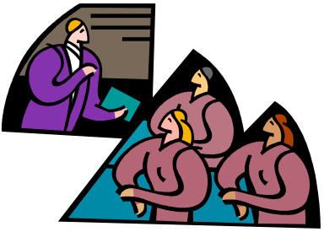
Linguistic-Word Intelligence Defined
People with this intelligence are skilled at words and language, whether spoken or written. The strengths of people with this intelligence vary within the scope of reading, writing, speaking, semantics, rhetoric, word games, poetry and storytelling.
Reading
Writing
Story-telling
Multiple Intelligences

Slide 4
Linguistic-Word Intelligence Activities
People with linguistic strengths enjoy activities such a reading, writing, talking and listening..
Reading
Writing
Story-telling
Multiple Intelligences

Slide 5
Word Smart People
Shakespeare
N Scott Momaday
Maya Angelou
Hemingway
Robert Frost
Mark Twain
Tony Hillerman
John Steinbeck
J. K. Rowlings
Elizabeth Barrett Browning
brainstorm some more…
Multiple Intelligences

Slide 6
Word Smart Careers
Poets, public speakers, journalists, writers (authors, advertising, script and speech writers), speech pathologists, lawyers, secretaries, editors, proofreaders, comedians, debaters, archivists, translators, TV and radio newscasters, commentators, announcers
Multiple Intelligences

Slide 7

VISUAL-Spatial Defined
(as in a sculptor or airplane pilot)
People with this intelligence are skilled and sensitive to the elements of art and their relationship to each other. Graphic representation of concepts / ideas.
Art
Video
Multiple Intelligences

Slide 8
VISUAL-Spatial Intelligence Activities
Learners with spatial intelligence think in pictures and images. Information presented or activities and performed in the designing, visualizing, drawing and doodling mode work best for this intelligence. Art videos, puzzles, illustrated text, and art museums are great stimulants for these kinds of learners.
Art
Video
Multiple Intelligences

Slide 9
VISUAL-Spatial People
Michelangelo
Leonardo da Vinci
Picasso
Van Gogh
Rembrandt
I.M. Pei
Frank Lloyd Wright
Annie Liebovitz
Steven Spielberg
Georgia O'Keefe
brainstorm some more…
Multiple Intelligences

Slide 10
VISUAL-Spatial Careers
Interior decorators, graphic design artists, cartographers, photographers, architects, airline pilots, surgeons, painters, sculptors, chefs (with their food presentations), quilters, needle point embroiders, landscapers, theater set designers, professional drivers, cinematographers, book illustrators, tour guides, jewelry and clothing designers
Multiple Intelligences

Slide 11


MATHEMATICAL-Logical
Intelligence Defined
(as in a scientist)
Sensitive to logical patterns
Ability to make inferences
Capacity to use numbers
Perform Calculations
Abstract thinking
Hypothesis development
Multiple Intelligences

Slide 12
MATHEMATICAL-Logical Traits
Experimentation
Ask many questions
Enjoys puzzles
Logical thinker
Masters calculations
Multiple Intelligences

Slide 13
MATHEMATICAL-Logical Activities
Calculators
Math manipulations
Science experiments
Science equipment
Math games
Critical thinking exercises
Multiple Intelligences

Slide 14

Musical Defined
(as in a composer)
Produce and appreciate forms of musical expressiveness
Multiple Intelligences

Slide 15
Musical Intelligence
Traits
If you are strong in this intelligence area, you likely have a love of music and rhythmic patters. You are probably very sensitive to sounds in the environment; the chirp of a cricket, rain on the roof, varying traffic patterns. You may study and work better with music in the background. You can often reproduce a melody or rhythmic pattern after hearing it only once.
Multiple Intelligences

Slide 16
Musical Intelligence
Activities
Analysis of song lyrics
Composition of song lyrics
Design and publish PowerPoint presentations which incorporate music and visual elements
Multiple Intelligences

Slide 17
Musical Intelligence
Careers
Music therapist, advertising professionals, motion picture soundtrack creators, music teachers, piano tuners, music studio directors and recorders, song writers, music performers, conductors, sound engineers, music copyists
Multiple Intelligences

Slide 18
Music Smart People
Mozart
Bach
Beethoven
Chopin
Scott Joplin
John Lennon
Stevie Wonder
Carlos Santana
Tupak
brainstorm some more…
Multiple Intelligences

Slide 19
Naturalist Intelligence
Defined
This intelligence involves understanding the natural world of plants and animals, noticing their characteristics, and categorizing them; it generally involves keen observation and the ability to classify other things as well.
Multiple Intelligences

Slide 20
Naturalist Intelligence Traits
Skillfully sorts and classifies rocks, insects,
shells, or dinosaurs.
Skilled in observing, collecting, and categorizing
Applied in the "human" environment as witnessed
in a child sorting sports cards,
Exploring nature, making collections of objects,
studying them, and grouping them.
Multiple Intelligences

Slide 21
Naturalist Activities
Naturalists understand the environment;
they learn well through outdoor activities,
including those that involve interacting with
natural and environmental materials and concepts.
Naturalists like maps, descriptive activities, and organizing data.
Multiple Intelligences

Slide 22
Naturalist Careers
Forest rangers, nature guides, animal trainers, zoo keepers, landscape designers, gardeners, scientists investigating the biological and physical worlds, bird watchers, veterinarians, farmers, people involved in scouting and camping, botanists, horticulturists, florists, meteorologists, conservations
Multiple Intelligences

Slide 23
Nature Smart People
Galileo
Rachael Carson
John Audubon
Lewis & Clark
Jane Goodall
Jacques Costeau
Diana Fossey
John Muir
Sacajawea
brainstorm some more…
Multiple Intelligences

Slide 24

Interpersonal Intelligence Defined
(as in a salesman or teacher)
Thrives on social interaction
Sensitive to others’ feelings
Can detect moods
Know others’ intentions
Social cues
Multiple Intelligences

Slide 25
Interpersonal Intelligence Traits
Team player
Sharing quality
Talks a lot
Many friends
Comfortable in a crowd
Enjoys multi player games
Leadership
Multiple Intelligences

Slide 26
Interpersonal Activities
Board games
Collaboration projects
Party supplies
Props for role playing
Productions like plays or musicals or team activities
Multiple Intelligences

Slide 27
Interpersonal Careers
Teachers, administrators, arbitrators, anthropologists, organization leaders (presidents and CEOs), sociologists, talk show hosts, politicians, public relations or customer service personnel, salespersons, travel agents, consultants, social affairs directors
Multiple Intelligences

Slide 28
People Smart People
Abraham Lincoln
George Washington
Ghandi
Oprah Winfrey
Jesse Jackson
Rev. Billy Graham
Martin Luther King
Multiple Intelligences

Slide 29
Intrapersonal Intelligence Defined
Understand oneself, engage in self-reflection & metacognition, capacity to be self-aware and in tune with inner feelings, values, beliefs and thinking processes.
Multiple Intelligences

Slide 30
Intrapersonal Intelligence Traits
These people often enjoy working alone, sometimes even shying away from others and off quietly by themselves. They are often strong willed, self-confident, and possess definite, well-thought-out opinions on various issues.
Multiple Intelligences

Slide 31
Intrapersonal Activities
you may like to work alone and sometimes you may shy away for others.
You are probably self-reflective & self-aware,
in tune with your inner feelings, values, beliefs, and thinking processes.
bearer of creative wisdom and insight, highly intuitive,
you are inwardly motivated
Multiple Intelligences

Slide 32
Self Smart People
Neil Armstrong
Helen Keller
Christopher Columbus
Charles Lindberg
Joan of Arc
Clara Barton
Cleopatra
Lief Ericsson
Sir Edmond Hilary
brainstorm some more…
Multiple Intelligences

Slide 33


Intrapersonal Careers
Therapists, psychologists, human potential researchers, philosophers, religious leaders (pastors and priests), social workers, mediation guides, counselors, self-help advisors, cognitive pattern researchers, mental health professionals
Multiple Intelligences

Slide 34


Bodily/Kinesthetic IntelligenceDefined
Ability to control body movements and handle objects skillfully.
Multiple Intelligences

Slide 35
Bodily/Kinesthetic Intelligence Traits
If you are strong in this intelligence area, you tend to have a keen sense of body awareness. You like physical movement--dancing, making and inventing with your hands, and role-playing. You probably communicate well through body language and other physical gestures. You can often perform a task much better after seeing someone else do it first and then mimicking those actions.
Multiple Intelligences

Slide 36
Bodily/Kinesthetic Activities
Those "at promise" in this domain enjoy and learn best from activities that use the body and involve movement, such as dance, crafts, mime, sports, acting and using manipulatives.
Multiple Intelligences

Slide 37
Body Smart People
Barishnakov
Cathy Rigby
Tiger Woods
Michael Jordan
David Copperfield
Marcel Marceau
Charlie Chaplin
Harry Houdini
Mia Hamm
brainstorm some more…
Multiple Intelligences

Slide 38
Reading
1) Read a play, fairy tale or drama suitable for classroom learning and your curriculum. Have the students enhance the story by putting it into newspaper form along with other poems, history of the period, and other relevant information using MS Publisher.
back to linguistic
Reading
Writing
Story-telling
Multiple Intelligences

Slide 39
Linguistic Intelligence Lesson Plan Idea
WRITING & STORY-TELLING
Choose a play to read in class.
The student will then create a character (themselves in role play) that will become a new character in the play.
How does self fit into the play? Describe self as character? Describe details of fitting into setting. Write some dialogue between self and at least one established character. Assemble the new story using MS Sound Recorder.
back to linguistic
Reading
Writing
Story-telling
Multiple Intelligences

Slide 40
VISUAL-Spatial Intelligence
Lesson Plan Idea
Adobe Photoshop Portrait
Students create a drawing or collage or edit a photo using Adobe Photoshop or other photo editing program to make a self-portrait.
back to visual / spatial
Art
Video
Multiple Intelligences

Slide 41
VISUAL-Spatial Intelligence
Lesson Plan Idea
History, Drama and Video
Students will create a video dramatizing a period in history which simulates a newscast.
back to visual / spatial
Art
Video
Multiple Intelligences

