Slide 1

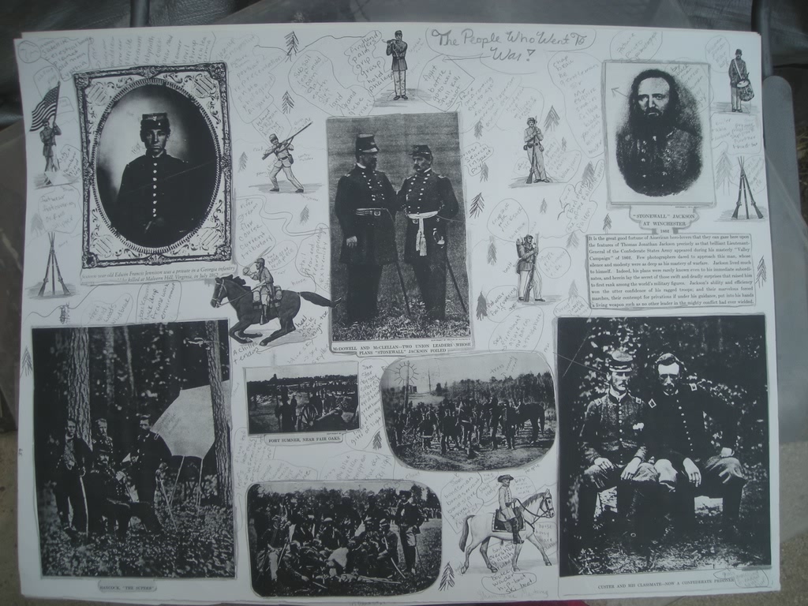

Slide 2
Story Telling
with
Multimedia capabilities
in
presentation software

Slide 3
TABLE OF CONTENTS
The Goal
The Objective
The Props
The Media
SETTING THE STAGE
SHOWTIME!

Slide 4

T h e Goal
Student Learning through:
Synergy of various sensory and disciplinary stimuli
Creativity when students invent roles for themselves to personalize a story about the past.
Finding Flow – The Psychology of Finding Engagement in Everyday Life. Mihaly Csikszentmihalyi
“Flow is important… The way to happiness lies not in mindless hedonism, but in mindful challenge.”

Slide 5
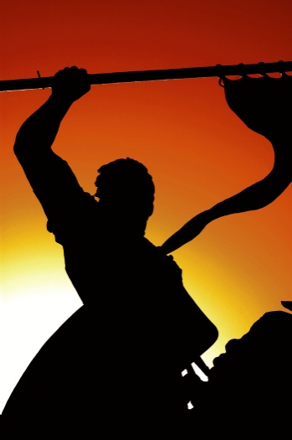
T h e o b j e c t I v e
Content Standards
Language Arts
1 READING AND LISTENING FOR COMPREHENSION:
Students will apply strategies and skills to comprehend information that is read, heard, and viewed.
A. Listen to, read, react to, and analyze information
D. Apply knowledge of reading process to evaluate print, non-print, and technology-based information.
Technology standards are spread throughout the NM Content Standards and Benchmarks. See LA 1-D above. This is typical of the standards in all the disciplines.

Slide 6


The props
Hardware:
Internet ready Computers, flash drive, microphones or mp3 player with recording capabilities, ear buds. Ideally each student should have a computer, a flash drive and ear buds, two to four students can share a microphone.
Technology standards are spread throughout the NM Content Standards and Benchmarks. See LA 1-D above. This is typical of all the disciplines.

Slide 7

The props
Software:
Presentation Software:
Microsoft PowerPoint, OpenSource (freeware)
Audio Recorder: Microsoft Sound Recorder
PowerPoint 2007 has audio recording capabilities.
Audio Editor: Audacity (freeware)
Format Converter: mediaconverter,
Audio Converter: NCH Switch

Slide 8
The props
Software Tips:
It’s worthwhile to poll your class on their knowledge in the use of internet searching methods, the electronic bookmark or favorite, and its export. (makes research links portable.)

Slide 9
The media
Copyright Issues
Most multimedia classroom projects classroom are considered to be free of copyright infringement issues.
Create bookmarks, hyperlinks, and a bibliography worksheet to keep track of resources electronically.

Slide 10
The media - Setting
Setting:
Sounds
Most formatting and editing issues can be solved using freeware suggested above. If a song is too long or a student has a sound idea for background to a narration, that can be achieved.
In a film or photo class, these techniques can also be further developed and applied.
Written permission is sometimes required to use sound files.

Slide 11
The media - setting
Images
Time and resources permitting, the images used in the presentation can include appropriate vocabulary labels.
In a film or photo class, using photo editing software, these techniques can also be further developed and applied.
Written permission is sometimes required to use sound files.

Slide 12
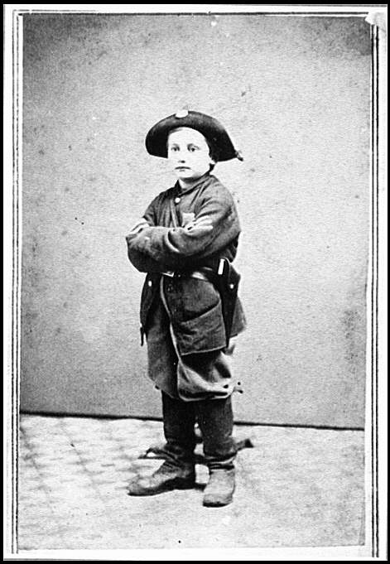
The media
Images
Face
Complexion
Expression
Knapsack
Satchel
Purse
Bag

Slide 13
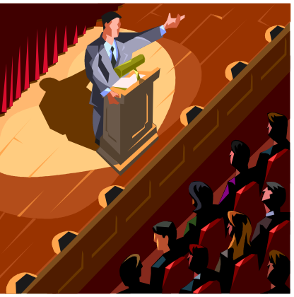
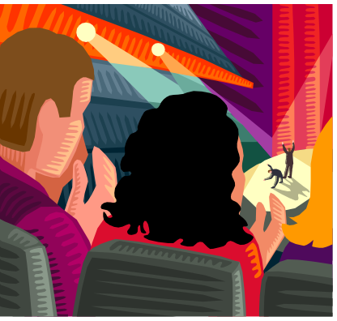
Setting the Stage
The Audience
Teacher:
adaptable to any grade level and still meet goals and objectives.
designed as a final project for freshmen.
Student:
meant to engage students of all ages, by transporting them into another time and place

Slide 14
Setting the Stage
The Audience
Student: ESL Students
Vocabulary Development
ELL Students

Slide 15

TABLE OF CONTENTS
WOUNDED
CIVIL WAR FASHION
CIVIL WAR DRUMMER BOYS
CIVIL WAR FIGURES
CREDITS
BIBLIOGRAPHY

Slide 16

WOUNDED
Or How I Became a Soldier
Kate Bagby 1st Period
Language Arts
Presented to Ms. Bagby
April 3, 2003
Ashokan Farewell
Morris Gallery of the Cumberland, Nashville, Tenn. photographer.
Notes:
Student must include an appropriate title, image, piece of music and appropriate credits for each.

Slide 17
Grasshoppers danced in the quivering blades of green and I was leaving home. The sky burst with a beautiful blue. The air was motionless as a sentinel, waiting and watching as if to commit to memory what was about to unfold in its midst.
I reckon my yearning for adventure came at the same time as the Negro’s yearning for freedom. Those ideas came to settle in my heart as I hoped a piece of lead or shrapnel never would. With hope as my beacon, and gunfire beginning to sound somewhere over the horizon, I headed onward toward the battlefields.
Morris Gallery of the Cumberland, Nashville, Tenn. photographer.
_________________________________________________
If there is no struggle, there is no progress. Those who profess to favor freedom yet deprecate agitation, are men who want rain without thunder. They want the ocean without the awful roar of its many waters…. Frederick Douglass (1817 - 1895) US lecturer, author

Slide 18

“Hey boy, you’re goin’ the wrong way,” a voice whispered loudly from a lush green gooseberry bush near the tree that shaded my path. “You turn back and skedaddle on home.” The voice erupted with urgency. You’re headin’ right into a dangerous field of fightin’. You know that?”
Why, I don’t know, but my thirst for adventure and the voice from the gooseberry bush made me want to skip with joy. But the panic and sheer terror in his voice sent my legs running on their original course. I just couldn’t stop or turn back. I ran on, keeping the brush along the road as my shield. With such great surges of emotion swelling up inside me, caution was difficult.
Morris Gallery of the Cumberland, Nashville, Tenn. photographer.
_________________________________________________
Be not discouraged. There is a future for you. . . . The resistance encountered now predicates hope. . . . Only as we rise . . . do we encounter opposition. Frederick Douglass (1817 - 1895) US lecturer, author

Slide 19
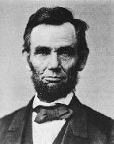
I had to watch and wait and think out a plan for whatever might happen to me between here and the horizon. Without a second thought, I slid belly first into a soft patch of grass and under the shade of trees. Just in front of me was a sharp rise and cover was intact. I crawled forward in the hopes of being able to see something besides trees, rocks, grass and talking bushes.
From my position on the rise, I had achieved a panoramic view. Only a few obstructions rose between me and the action. I looked off to the right in shock at the presence of what looked like spectators of the war. They were actually having a look at the battle with those new fangled spy glasses.
Morris Gallery of the Cumberland, Nashville, Tenn. photographer.
_________________________________________________
Civil War 1861-1865 "Fellow citizens, we cannot escape history.”
Abraham Lincoln,

Slide 20
Being only 12 years old, I figured I’d left home just in time. “My education has begun,” I said to myself.
I wrestled my bag around so I could pull out a piece of bread to chew on. It made me feel like I belonged with the other spectators looking at the war, and I was able to calm down.
I soon dropped off to sleep. I was awakened from my nap by the sound of someone moving quickly my way. I rolled over and in underneath another bush and waited for whoever it was to come into view. Looking haggard, dirty, bloody and tired was a boy not much older than me. He was unarmed and looked like he’d seen a ghost. Just in front of the bush I was hiding under, he collapsed. “Doggone it! I ain’t no doctor,” I said.
Morris Gallery of the Cumberland, Nashville, Tenn. photographer.

Slide 21
As if in response to my grumblings, the young soldier groaned and opened his eyes. “Are you wounded from the battle over yonder, I asked?”
“No kid,” was his reply. “Where you comin’ from?” he asked me.
Not to give too much away, I changed the subject and offered him some bread. “What’s your name?” I asked.
He didn’t want to give away any information either. He asked me, “Kid, what are you doing out here?”
Thinking maybe he could help me, I said, “I ran away from home yesterday, and want to join up with a regiment to fight the rebs. Can you help me find some fighting?”
Morris Gallery of the Cumberland, Nashville, Tenn. photographer.

Slide 22
His eyes studied me from beneath a pair of knitted eyebrows and above sun burnt cheeks and cracked lips. “I don’t know about you and fightin’, kid,” he said. It’s pretty tough over there with all the killin’. You look like a young pup to me.”
He scratched the back of his neck as he continued to study me. I wanted to ask him why he was over here! Just as I was ready to interrogate him, he said “I know, we need a drummer boy and you look like just the kid, kid.”
Morris Gallery of the Cumberland, Nashville, Tenn. photographer.
________________________________________________
"A man watches his pear-tree day after day, impatient for the ripening of the fruit. Let him attempt to force the process, and he may spoil both fruit and tree. But let him patiently wait, and the ripe pear at length falls into his lap!“ Abraham Lincoln

Slide 23
I beamed with pride at the thought of being a drummer boy. Both of us had a moment of contentment before we heard the approach of soldiers and enemy fire. I looked to see if the spectators were still on the adjacent hill. They had gone while I talked with the soldier. Out of the blue came an enemy regiment. We both ducked back in under the brush. My new friend had turned white as a sheet, and began to tremble. I crawled around under the row of shrubs to see what I could.
Morris Gallery of the Cumberland, Nashville, Tenn. photographer.
________________________________________________
I worked night and day for twelve years to prevent the war, but I could not. The North was mad and blind, would not let us govern ourselves, and so the war came. Jefferson Davis

Slide 24
Over the edge of the rise, where I had felt safe, came the rest of the screaming and shooting rebel unit. Before I knew it we were under attack. Gunfire was coming from both sides. I wish I had gotten the name of the young soldier beside me, he had fainted or wasn’t conscious anymore.
It was either die here or run like hell out of harm’s way. Maybe that was what the young soldier had done, and here the battle was, on him again.
Morris Gallery of the Cumberland, Nashville, Tenn. photographer.
________________________________________________
All we ask is to be let alone. Jefferson Davis (1808 - 1889) US political leader First Message to the Confederate Congress, Mar 1861.

Slide 25

So I ran as fast as I could, off to the side keeping as low as possible. The noise was deafening. I prayed that I lived to see my home again. BOOM! The shooting intensified. I had been hit by the rebel army. My upper arm burned like fire with the hit from the shrapnel. I had to make it to safety and out live this battle to save my new found friend who lay unconscious in the bushes.
Morris Gallery of the Cumberland, Nashville, Tenn. photographer.
~~THE END~~
________________________________________________

Slide 26
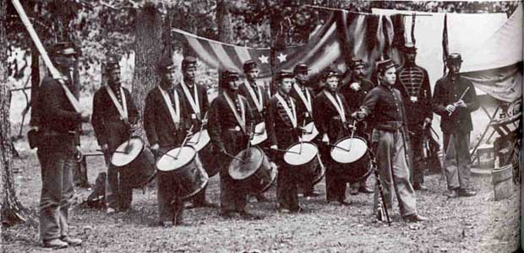
Jim Murphy, THE BOY’S WAR Confederate and Union Soldiers Talk About the War, New York, Clarion Books, 1990.
CIVIL WAR DRUMMER BOYS

Slide 27
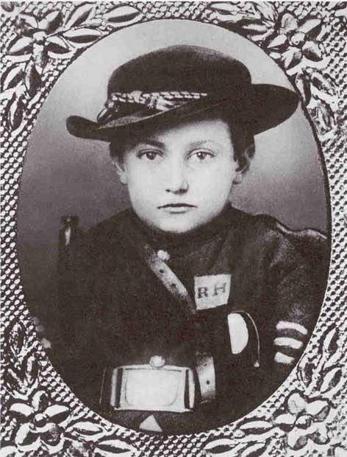
Johnny Clem, 12, just after the Battle of Shiloh, 1862. This drummer boy turned soldier after his drum was destroyed in battle.

Slide 28
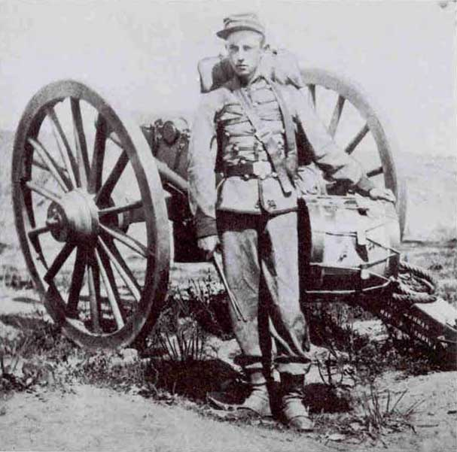
A Union drummer boy in full uniform.

Slide 29
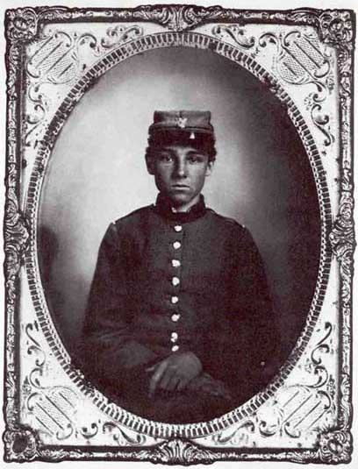
Sixteen year-old Edwin Francis Jennison was a private in a Georgia infantry regiment. He would be killed at Malvern Hill, Virginia, in 1862.

Slide 30
CIVIL WAR
FASHION

Slide 31
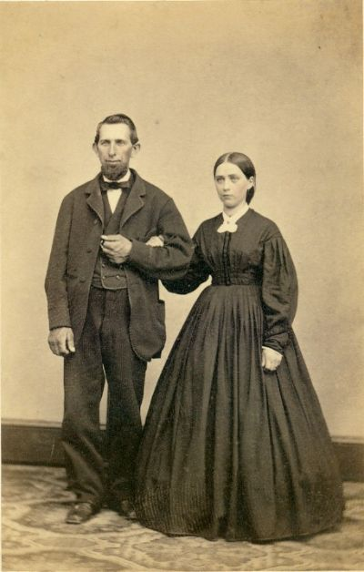
This is an example of A relatively simple Civil War era dress and suit. The woman’s dress includes, typical elements such as the dark dress with contrasting collar, wide shoulders and sleeves widening just at the narrow waist. The waist is accentuated by the hoop skirt, and topped off with a simple hair style.
Here is an Unidentified woman and man from the Civil War period, This photograph was shot at Charles W. Eberman studio in Pennsylvania between 1860-1865.
Images from an original CDV, circa 1860s.
Photographer: Charles W. Eberman.
Images © Jone Lewis 2001

Slide 32
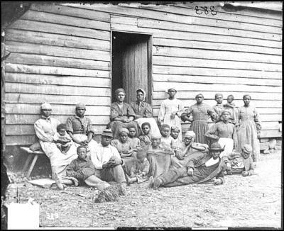
A group of "contrabands" or ex-slaves at Cumberland Landing, Virginia.
About 22 women, children and men.
As for simplicity and taste in dress, this look has stood the test of time.
May 14, 1862. Photographer: James F. Gibson.

Slide 33
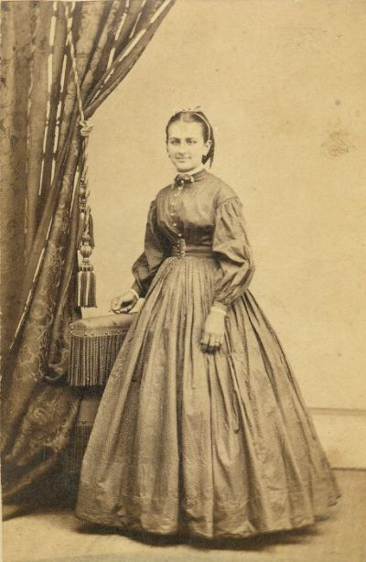
This dress is worn by a married and well to do young woman, (note the ring on her left hand.) The hair ribbon decorating her hair is worn in the typical style of the period. The collar is somewhat fancy. again the sleeve is very wide at the point where it contrasts with the small waist. The White detail at the collar and cuffs is convenient for cleaning and replacing as well as lending a bit of fashion interest.
Unidentified woman, Civil War period, Patton and Lee studio, Pennsylvania. About 1860-1865.
Images from an original CDV, circa 1860s.
Photographer: Patton and Lee.
Images © Jone Lewis 2001.

Slide 34
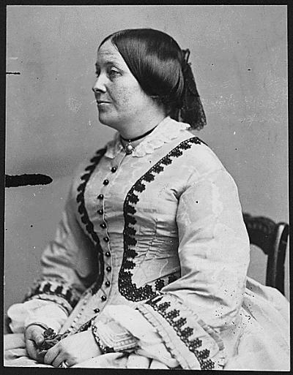
This is a great example of the fancy flat ruffle work typical of the “special Occasion” dress of the Civil War woman during the 1860s. Notice the choker, bracelet and wedding ring.
Image courtesy of U.S. National Archives and Records Administration.
Photographer: Mathew Brady Studio.
Modifications © Jone Lewis 2001.

Slide 35
CIVIL WAR FIGURES

Slide 36
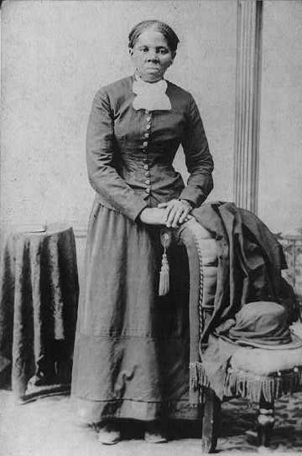
A woman of uncommon commitment and strength, Harriet Tubman, became the liberator of many a slave due to her courageous leadership in the underground railroad. The underground railroad was a chain of safe points that, if taken safely, would lead a slave out of the south and into the north to freedom.
Picture courtesy of the Library of Congress.
Scanned and modified for the web by Jone Johnson Lewis.
Image © 2002 Jone Johnson Lewis. to About.com.

Slide 37
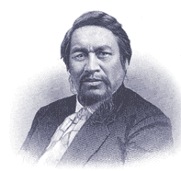
Ely S. Parker, a Seneca Indian, was one of General Grant’s favorite aids.
Before the Civil war he was a instrumental in negotiation that returned 2/3rd of the Tonawanda Seneca's reservation land.
http://www.pbs.org/warrior/indexf.html

Slide 38
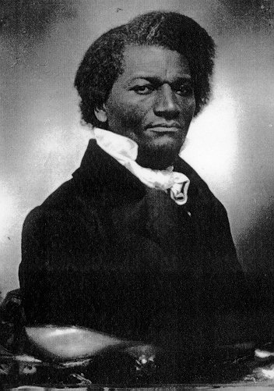
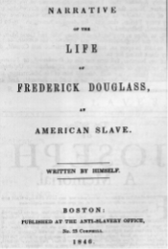
Frederick Douglass grew up in slavery. He educated himself, It was doubted later in his life that he ever was a slave. In response to that characterization, he wrote his autobiography.

Slide 39
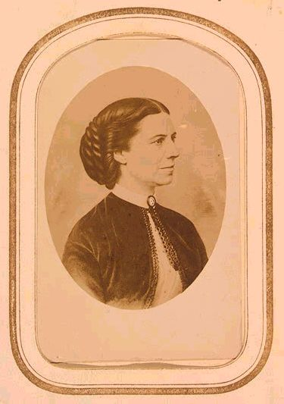
Clara Barton worked during the Civil War, first collecting medical supplies and then on the battlefield and in hospitals. She became the founder of the American Red Cross.
Image courtesy of U.S. Library of Congress, Prints and Photographs Division.
Modifications © Jone Lewis 2001.

Slide 40
CREDITS
Kate Bagby
Writer
Graphic Designer
& Content Architect

Slide 41
BIBLIOGRAPHY
Tubb, Benjamin. The Music of the American Civil War. April 27, 2003. McClellen is the Man. http://users.erols.com/kfraser/union/songs/index.html. [Used with Permission]
Creative Quotations from Jefferson Davis, Creative Quotations,. April 27, 2003. <http://www.creativequotations.com/one/1401.htm.>
Griessman, Gene. Gene Griessman is telling Secrets. April 27, 2003. < http://www.presidentlincoln.com/index.html.>
Lewis, Jone Johnson. Women and History About.com Women’s History and the Civil War. April 27, 2003. <http://womenshistory.about.com/library/pic/bl_p_civil_war.htm.>
A Warrior in Two Worlds. April 27, 2003. Public Broadcasting Service. <http://www.pbs.org/warrior/>
Jim Murphy, THE BOY’S WAR Confederate and Union Soldiers Talk About the War, New York, Clarion Books, 1990.

