Slide 1

How to write a report
Using the K-W-L method
to outline and research

Slide 2

Steps to writing a quality paper
The goal is for you to learn new information and to teach others that new information.
Step 1: Determine what you already know and what you would like to know.

Slide 3




K-W-L: A three step process
1. Write down what you know: K
2. Write down what you want to know . . .
What you want to learn: W
Do your research
3. Write down what you have learned: L

Slide 4
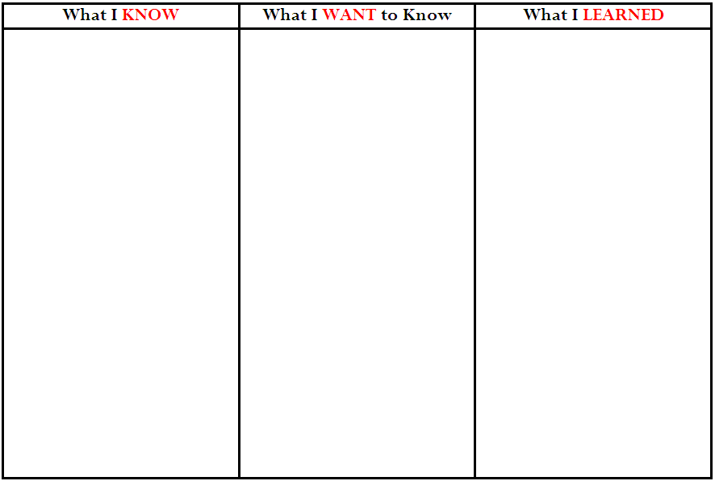

Slide 5

Meet Margot Sanchez
Probably is a female
Her last name seems Hispanic

Slide 6
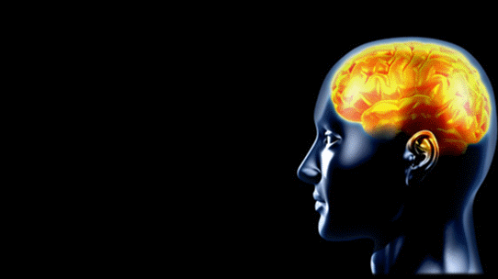
Writing is Psychological
You write best when you are into it.

Slide 7


Writing is a process
Think about it:
The application to type documents is called a
word processor.

Slide 8
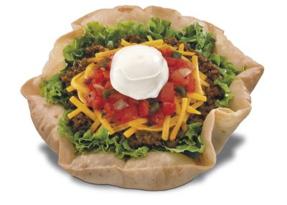

Writing is like a taco salad
Writing is layered with different, yummy ingredients.
Remember: Writing is psychological.
Find a technique that breaks up the task into manageable parts and motivates you along.

Slide 9
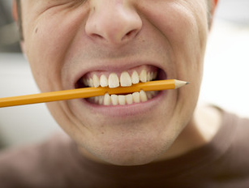
i hate writing!
why do you think we have to use a “number 2” pencil?

Slide 10
Step 1: Write down what you know – K
Example: Thanksgiving
Thanksgiving is sometime in late November, always on a Thursday
Turkey, cranberries, and pumpkin pie seem to be traditional favorites
The pilgrims and Indians shared a meal one year after the Puritans landed at Plymouth Rock
The day after Thanksgiving—Black Friday—is the biggest shopping day of the year and kicks off the Christmas season.
On Thanksgiving day, college football bowl games are played.

Slide 11
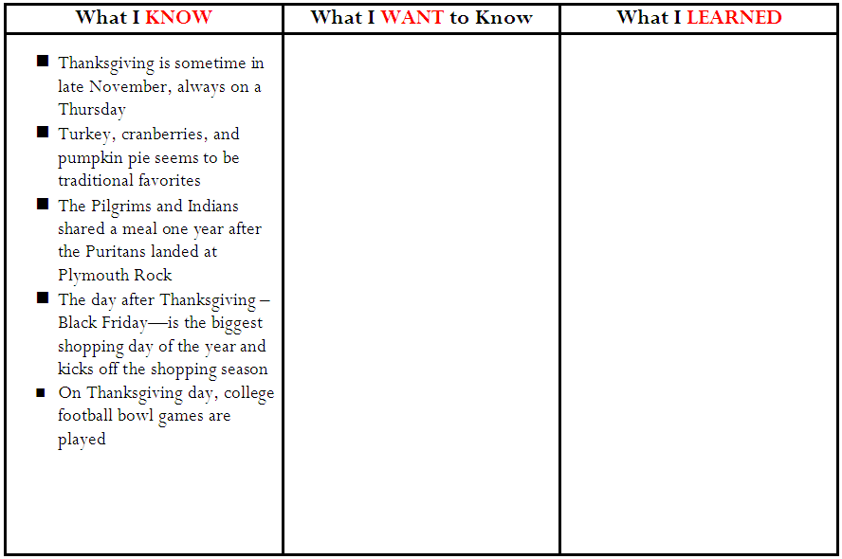

Slide 12
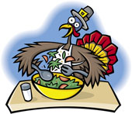
Step 2: List what you want to know – W
When exactly is Thanksgiving and how and when did the date get set as an official holiday?
Do other countries celebrate Thanksgiving?
How did turkey, cranberries, and pumpkin pie become traditional favorites?
How much turkey, cranberries, and pumpkin pie is bought and eaten on Thanksgiving?

Slide 13

Step 2: List what you want to know – W
What is the myth and what is the historical fact concerning the Pilgrims, Indians, and the first Thanksgiving?
Did the Pilgrims really wear those crazy buckle hats?
When did Black Friday become such a big shopping day and how much money is spent that day?
What football bowl games are played on Thanksgiving and when did that start?
What teams return year after year to play?

Slide 14


Slide 15
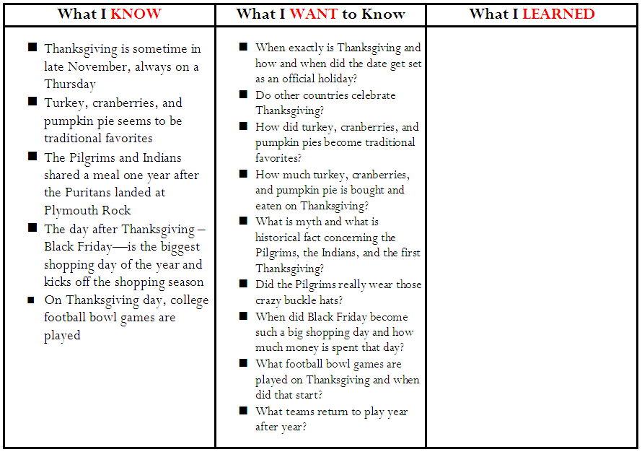

Slide 16
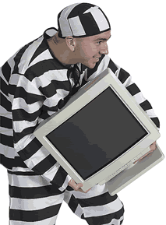
Don’t swipe another’s type!

