Slide 1
Post-Modern
Principles of art
What is Post-Modernism anyway?
Post-Modernism holds realities to be plural and relative, and dependent on who the interested parties are and what their interests consist in. It attempts to problematise modernist overconfidence, by drawing into sharp contrast the difference between how confident speakers are of their positions versus how confident they need to be to serve their supposed purposes. Postmodernism has influenced many cultural fields, including literary criticism, sociology, linguistics, architecture, visual arts, and music. (wikipedia)

Slide 2
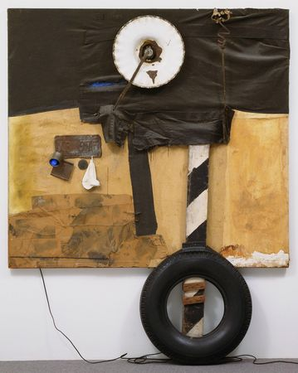
Juxtaposition
Robert Rauschenberg revolutionized expressive painting when he substituted the seemingly random juxtaposition of found images for personally generated abstract marks (Forge, 1972). The modernist principle of contrast is not adequate to describe the energy generated by bringing together radically disparate elements, an artistic strategy utilized since Dada photomontage and Surrealist objects such as Meret Oppenheim's fur-covered teacup (Burckhardt & Curiger, 1996). The term juxtaposition is useful in helping students discuss the familiar shocks of contemporary life in which images and objects from various realms and sensibilities come together as intentional clashes or random happenings.

Slide 3
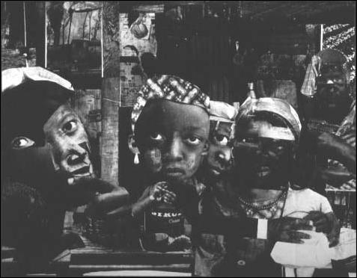
Appropriation
One of the most striking things about many of the curriculum projects was the routine use of appropriated materials. Whether created in the spirit of Romare Bearden's histories of the African-American experience composed of fragments of found photos (Bearden & Henderson, 1993) or), the student artwork often used print materials as the stuff out of which their art was composed. For the students, recycling imagery felt comfortable and commonplace. If one lives in a forest, wood will likely become one's medium for creative play. If one grows up in a world filled with cheap, disposable images, they easily become the stuff of one's own creative expression.

Slide 4
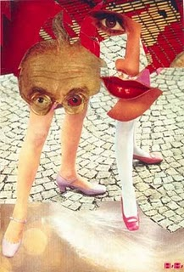
Recontextualization
Often, positioning a familiar image in relationship to pictures, symbols, or texts with which it is not usually associated generates meaning in an artwork. Hannah Hoch, an early Dada proponent of the new medium of photomontage, created provocative works by recombining found imagery. In Die Braut of 1927, winged objects swirl around the central image of a traditional bride and groom. The woman's head is replaced by an oversized image of a young child's face Gfakela & Boswell, 1996). This simple move changes any potential romantic fantasy readings of the bridal couple, shifting the focus to society's degrading legal, religious, and Acultural conventions regarding the status of women.

Slide 5
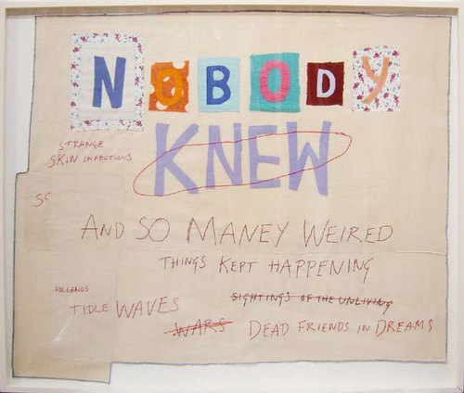
Representin’
U.S. urban street slang for proclaiming one's identity and affiliations, representin' describes the strategy of locating one's artistic voice within one's own personal history and culture of origin. Shirin Neshat creates video installations and photo text works that explore the psychological conditions of women in Islamic societies (Grosenick2001). It is important that art classes provide students with opportunities for meaningful self-expression in which they become representin', self-creating beings. These opportunities should allow students to see examples of contemporary artists using art making to explore the potentials and problems inherent in their own cultural and political settings (Gude,2003).

Slide 6
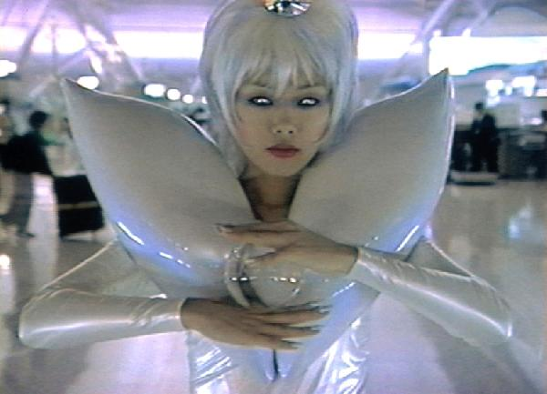
Hybridity
Many contemporary artists incorporate various media into their pieces, using whatever is required to fully investigate the subject. Contemporary artists routinely create sculptural installation is utilizing new media such as large-scale projections of video, sound pieces, digital photography and computer animation. Indeed, multi-media worlds of art are now encountered in contemporary museums and galleries more frequently than traditional sculpted or painted objects. The concept of hybridity also describes the cultural blending evident in many works. New York and Tokyo-based Mariko Mori draws on costuming, make-up, popular culture, and traditional Buddhist beliefs to create complex photographic and video installations. Her work explores boundaries between spirituality and cyberculture, between the human and the re-creation of the human through technology (Finebery, 2000).

Slide 7
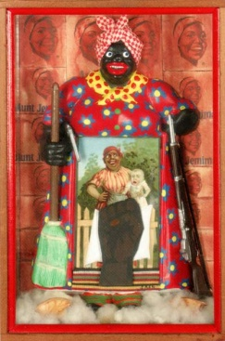
Gazing
In Betye Saar’s The Liberation of Aunt Jemima, the traditional meaning of the saccharine image is challenged when it is presented with an even more stereotypical depiction of a wide-eyed, red-lipped African-America woman holding a broom in one hand and a rifle in the other, juxtaposed with a life-sized Black Power clenched fist (broude and Garrard, 1994). By shiftinig the context within which a familiar advertising image is seen, students spontaneously question who creates and controls imagery and how this imagery affects our understandings of reality.—an important activity of visual cultural art education.

Slide 8
LAYERING:
Students explored their fears and hopes after the tragedy of September11 by muting and layering images and text onto the headline newspaper pages of those terrible days. Are You There Yet? by high school student Kristy Puritan created at Spiral Workshop 2001.
Though deconstruction has a more specific meaning in the theory of Jacques Derrida (Glusberg, 1991), in everyday art world parlance, recontextualization and deconstruction can often function synonymously. The magazine Adbusters has many examples of deconstructing contemporary advertisements by pairing the original ads with fragments of other images and texts that contextualize the consumer fantasies within environmental and images and texts that contextualize the consumer fantasies within environmental and global justice discourse.

